Slide 1
Experimenting with Data and IoT in the urban space: the case of Trikala
Leonidas Anthopoulos
Associate Professor TEI of Thessaly, Greece
Mayor’s Special Advisor, the city of Trikala, Greece
Head of the Greek Smart City Standardization Group

Slide 2
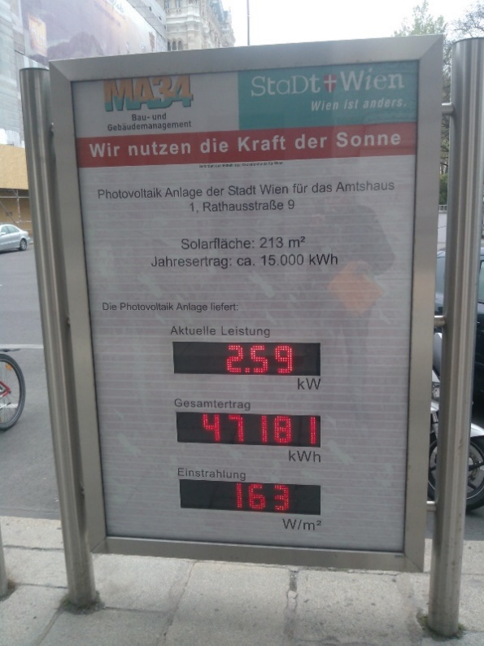
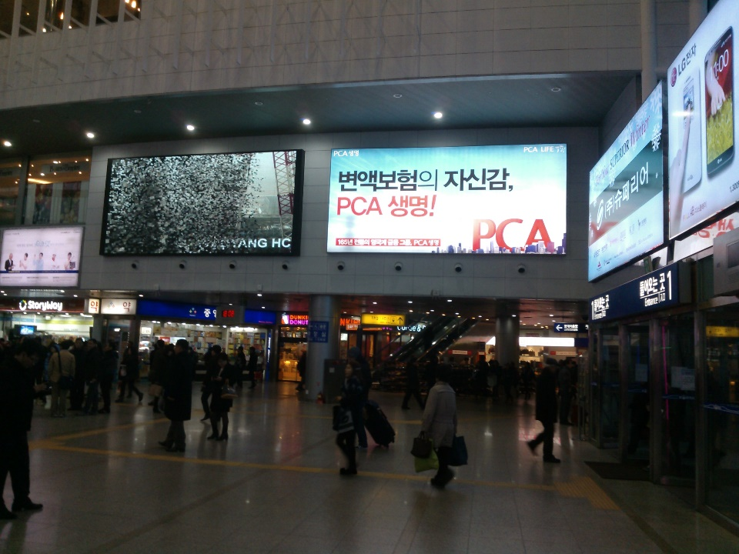
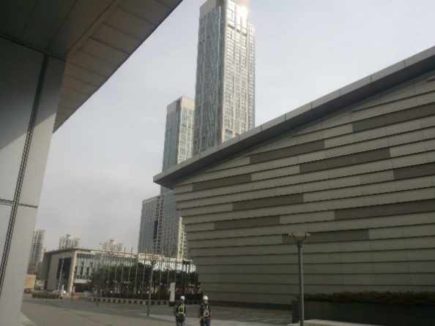
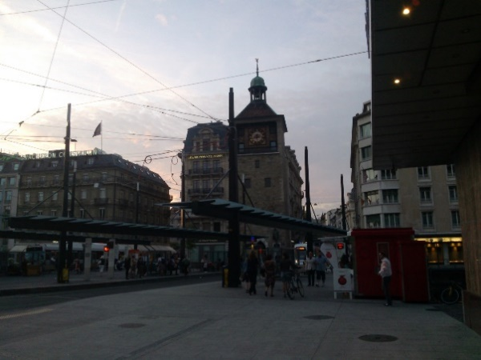
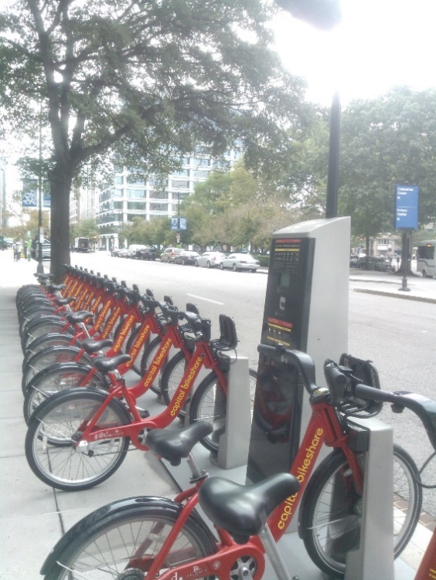
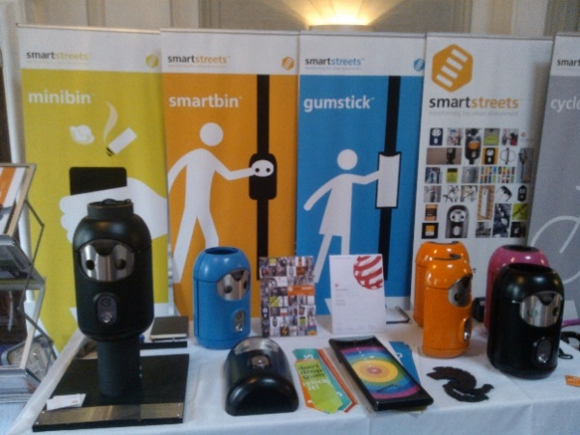
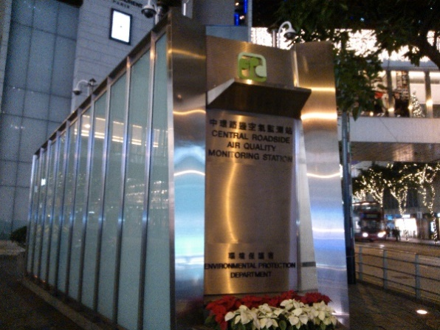
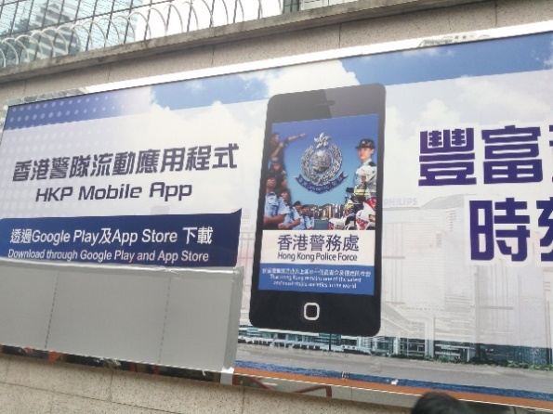
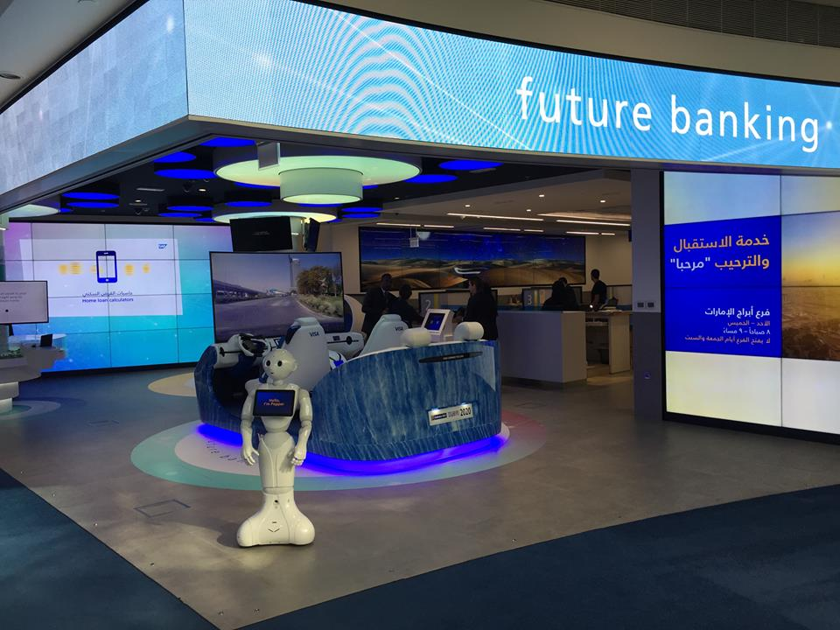
What do SC do with IoT?
Energy monitoring: Vienna
Smart bikes: Washington
Smart monitors: Seoul
Smart buildings: Songdo
Smart signs: Geneva
Smart environment: Hong Kong
Smart bins: London
QR codes: Hong Kong
Future banking: Dubai

Slide 3
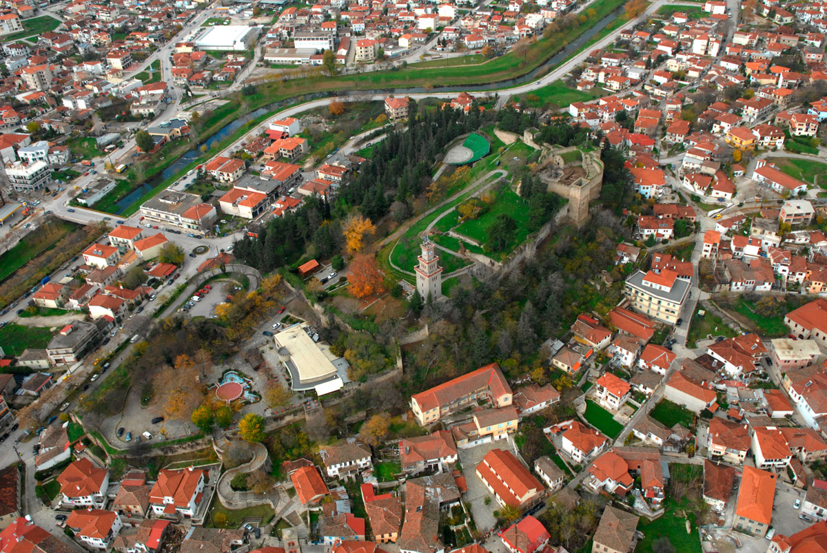
5.000
Years of history.
Birthplace of Asklepios (Aesculapius), the first doctor of the universe!
81.355
Inhabitants.
The Municipality consists of the city of Trikala surrounded by 34 villages
Area: 608 km2

Slide 4

6.000
famous Greek songs were composed
and performed by:
Tsitsanis, Virvos
Kaldaras, Samoladas, Mitropanos, Kolokotronis
Νο.1
Prefecture in bottling Tsipouro (famous Greek drink)
and feta cheese
Also famous the Trikalian sausage!

Slide 5
Strengths
Experimenting in Trikala
Weaknesses
Agriculture
Strong higher education system
A long “smart” story
Branding (Elves Mill)
Coherent community
Low local GDP
High levels of unemployment
Only 2 university departments
National «Brain drain»

Slide 6
Opportunities
Experimenting in Trikala
Threats
Brand new transportation networks
Regional Mobility
Regional Innovation Strategy (RIS3)
International recognition
Emerging technologies (STEM, precise architecture etc.)
Political and economic uncertainties
Changes in tertiary education
Climate change effects to local GDP
Immigration and community changes

Slide 7
Trikala: a brief smart story
2003: e-Trikala digital City
2005: wireless city
2007: broadband city
2008: intelligent transportation
2014: smart strategy
2015: automated bus
2016: smart Trikala
2017: 5G pilot
2018: STEM
2018: IoT ready city
2018: Data portal
Next? Innovation Hub

Slide 8
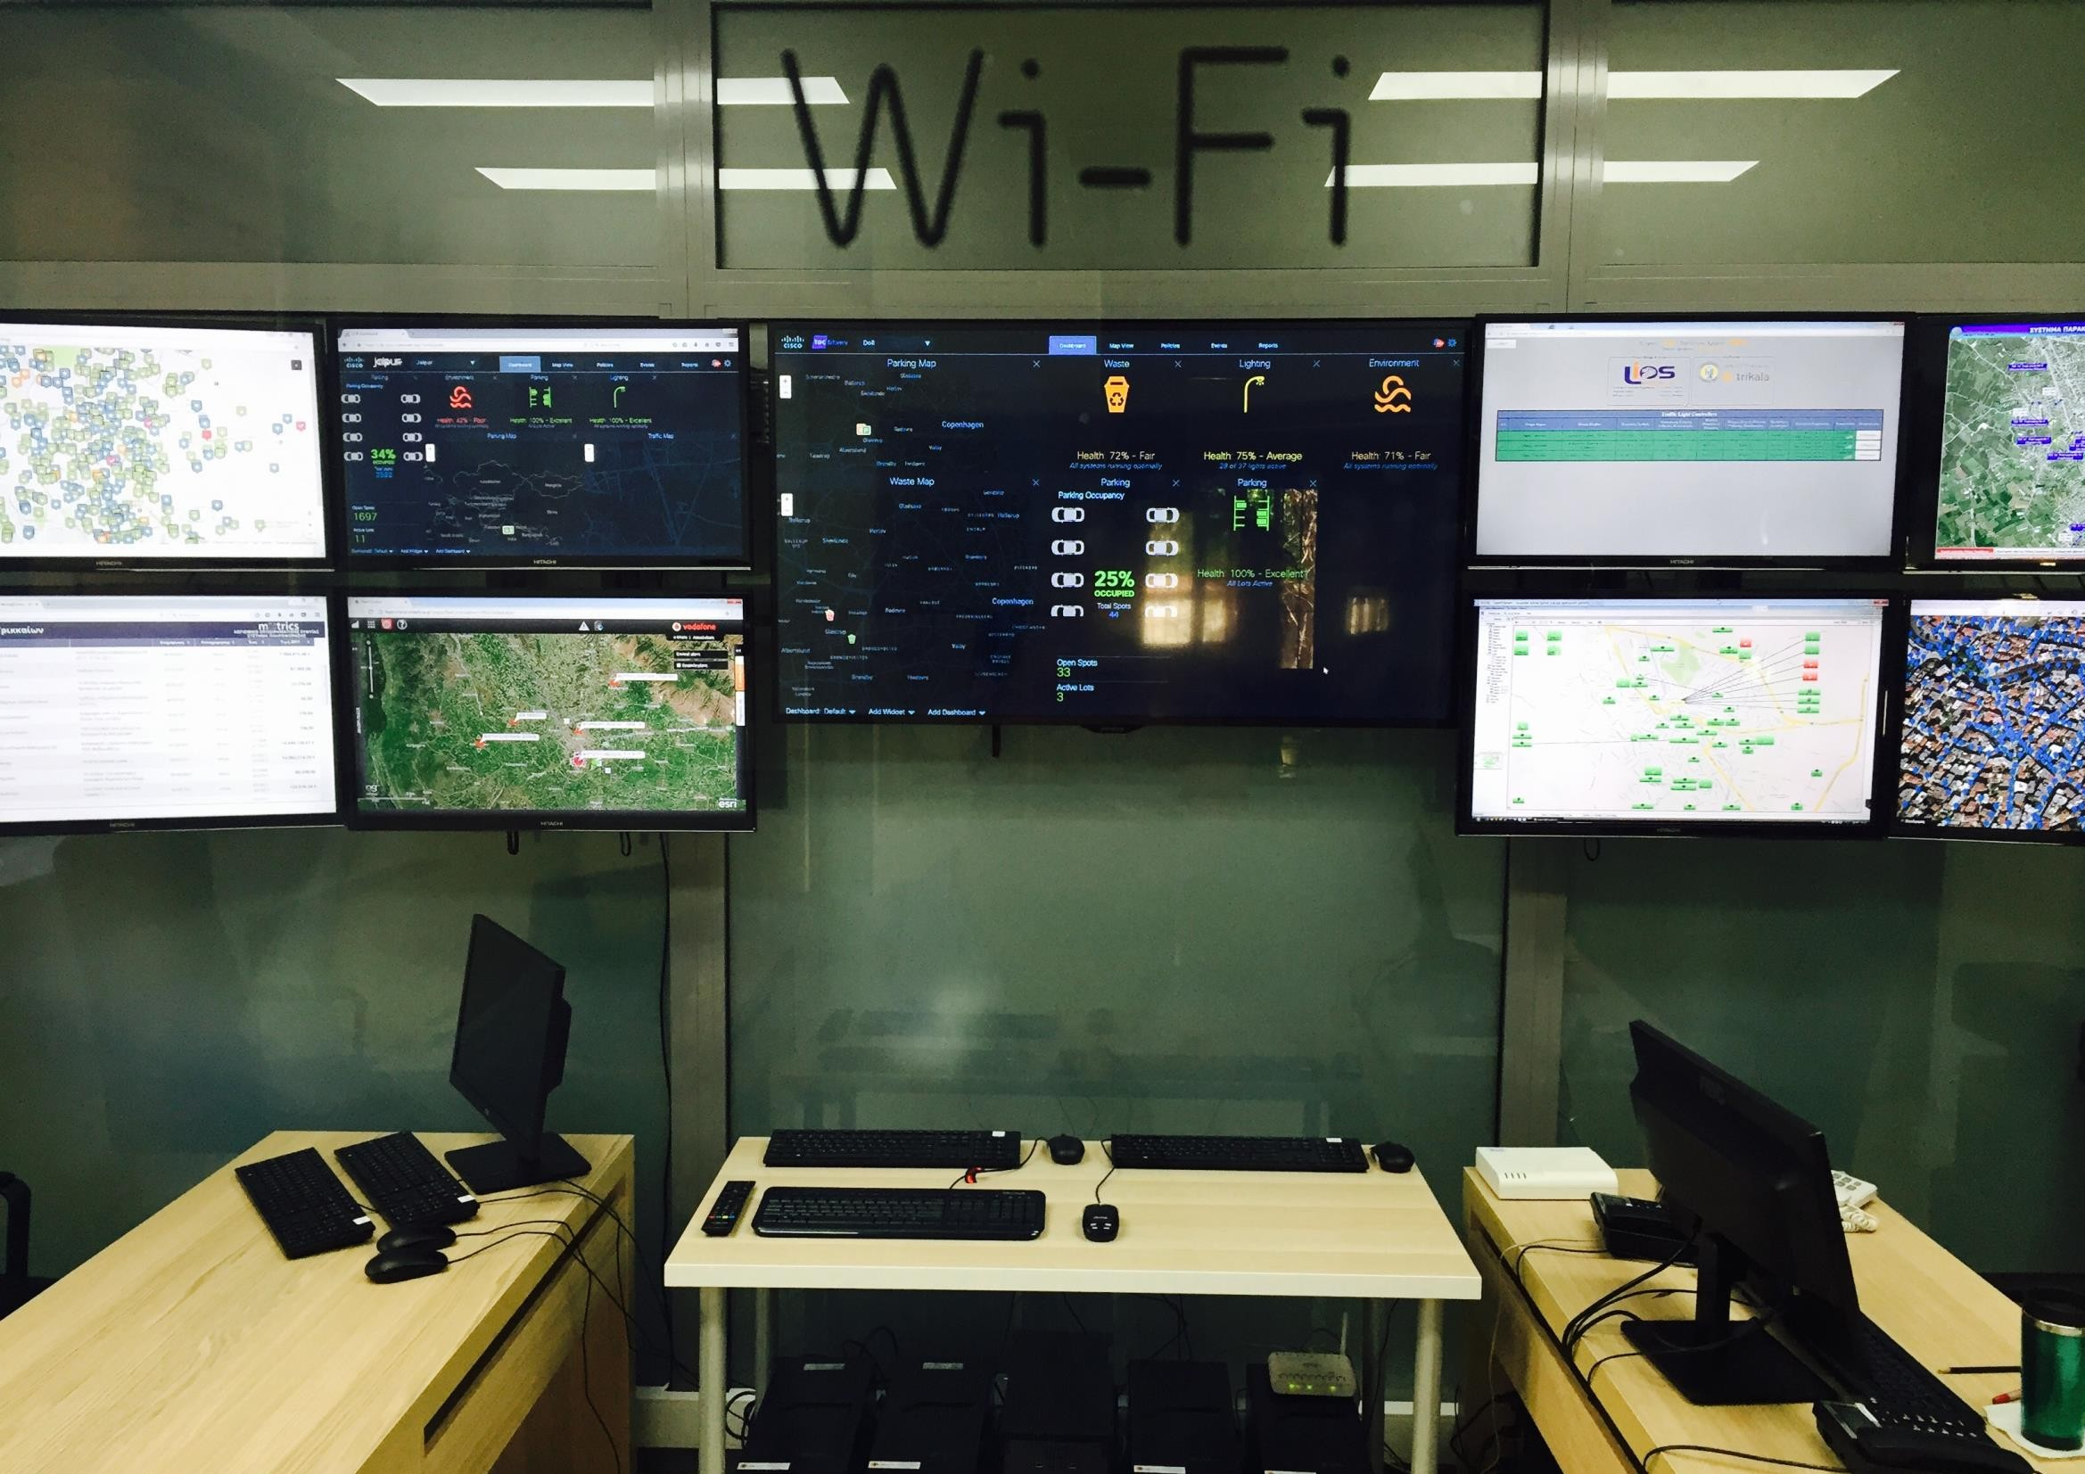
smarTrikala
Municipal control room
Although the long “smart” story, the citizens were listening to “smart solutions” but the didn’t receive “smart” result! That’s why we installed the Municipal control room at the entrance of the City Hall.
So that they can realize that technology can truly improve their life!

Slide 9
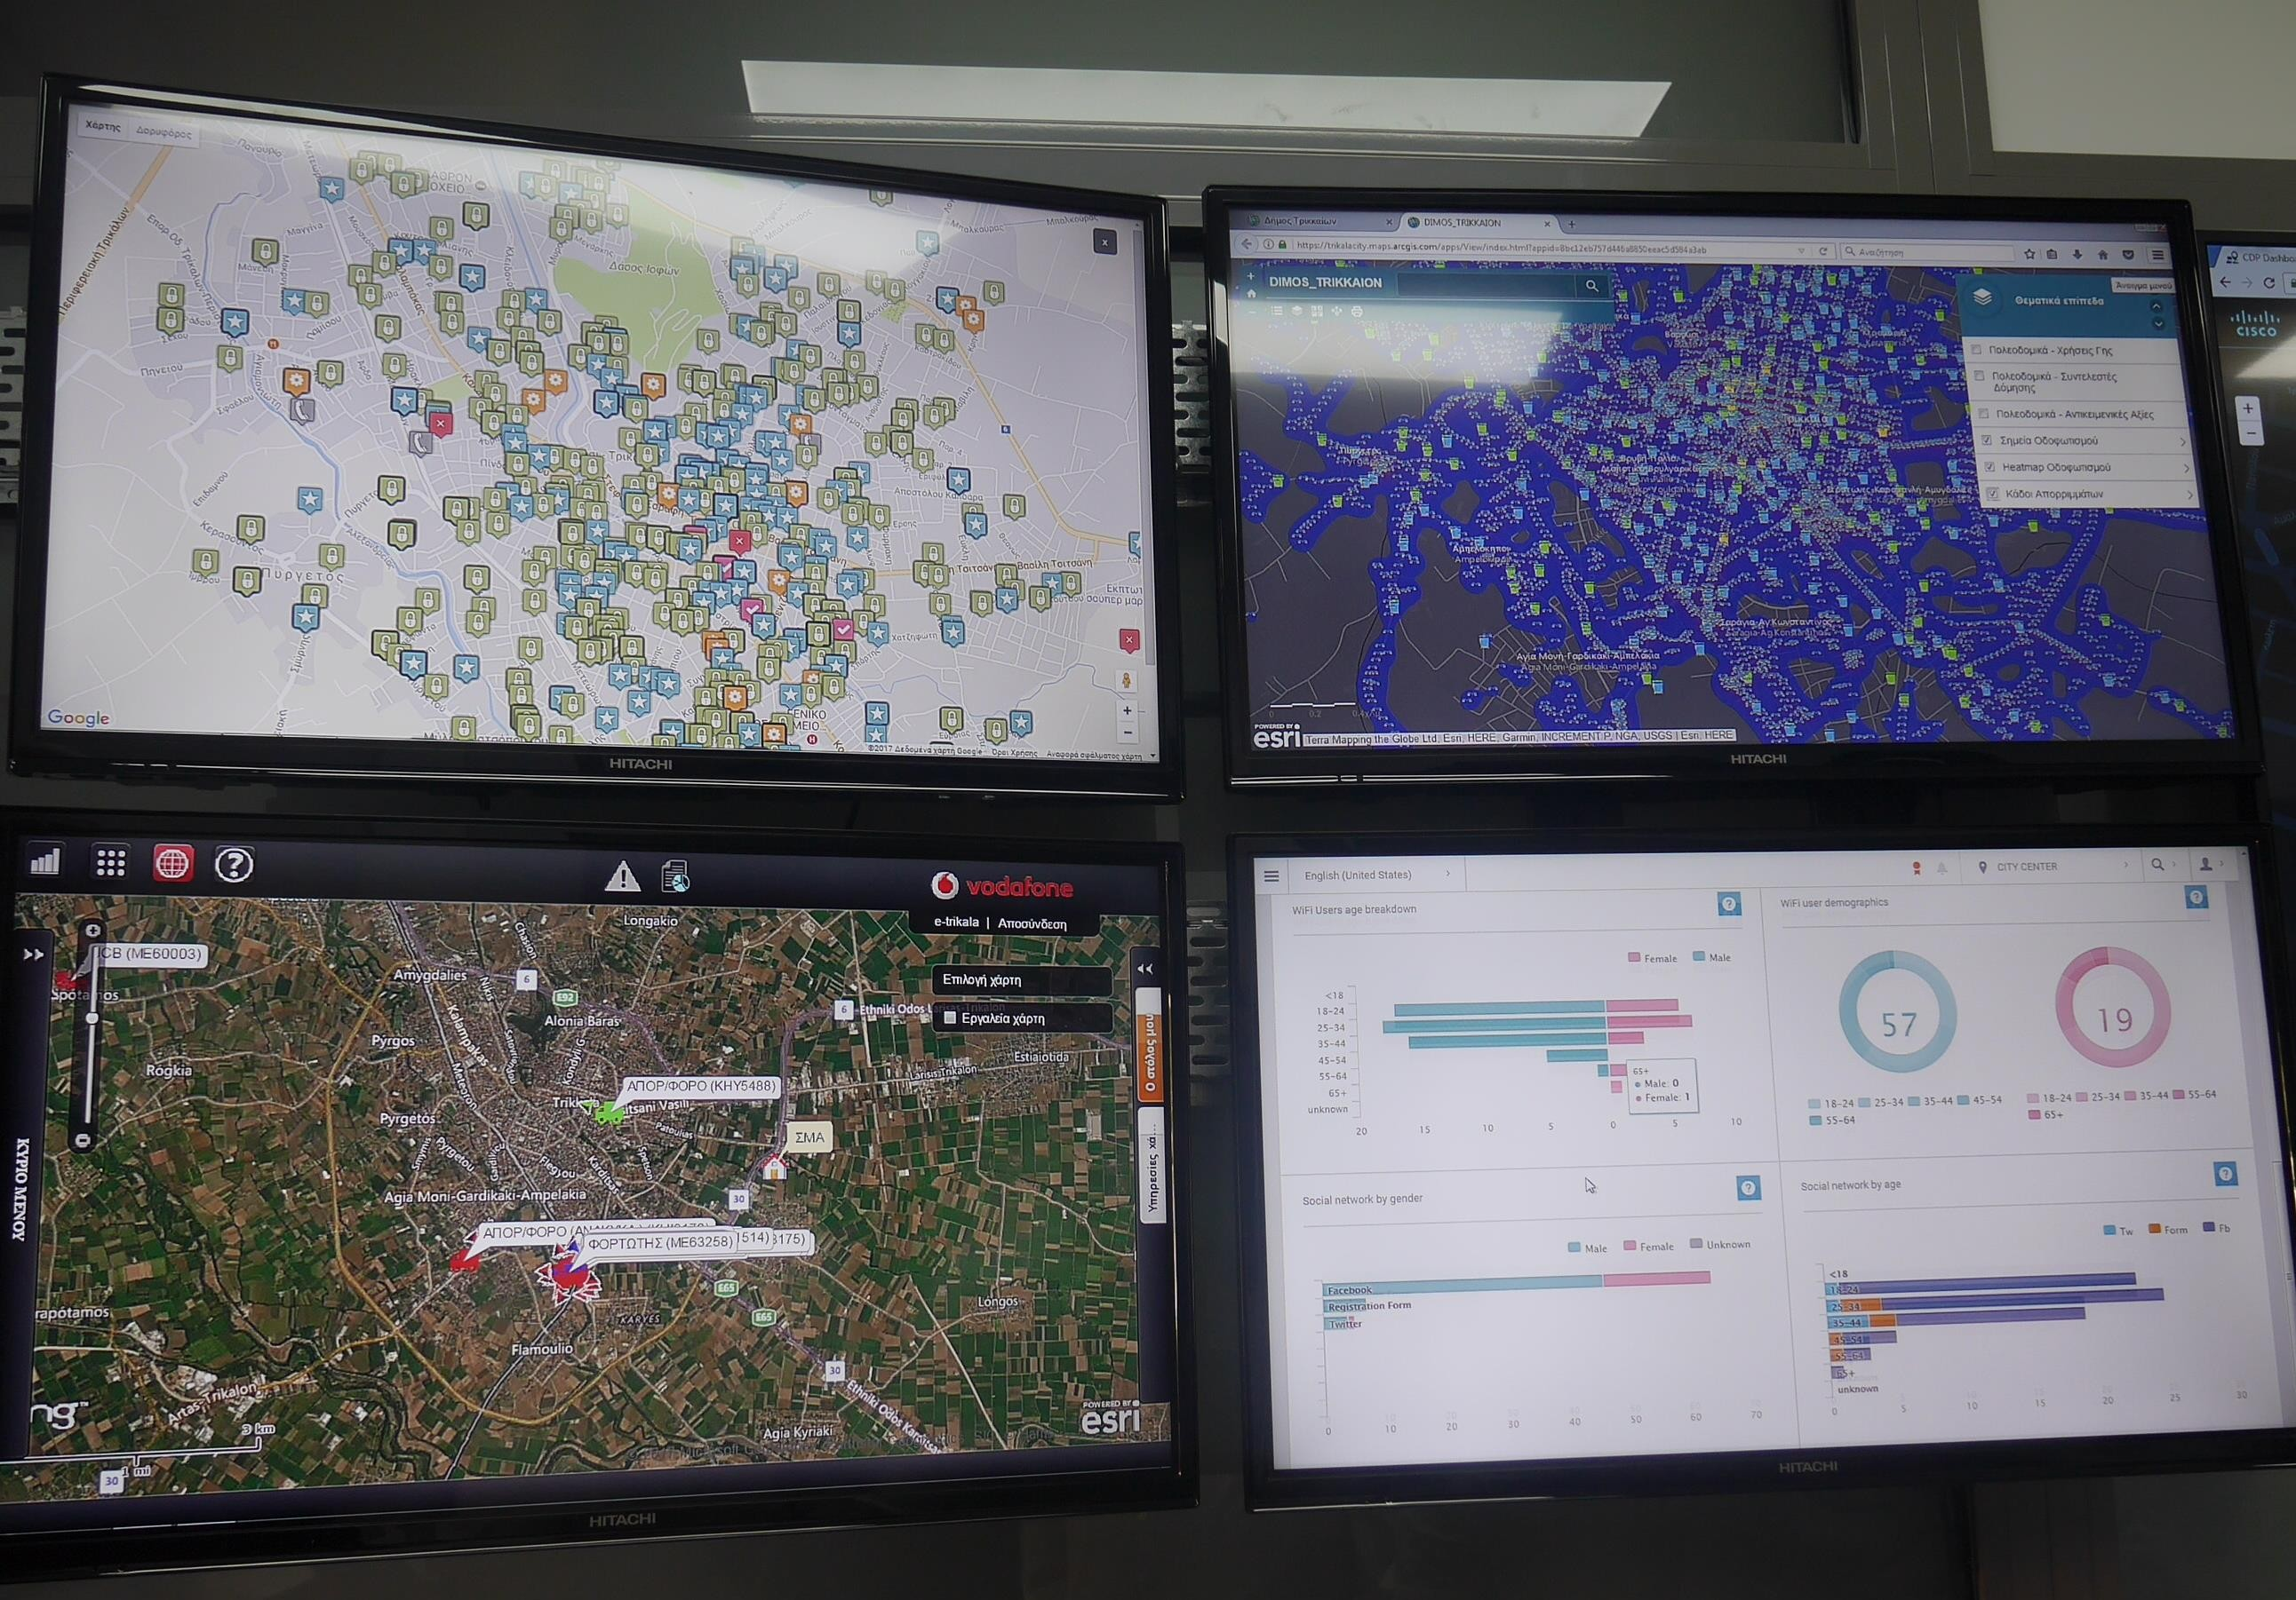
A brief tour in the control room!
Municipal call center- Citizen claims and “complaints” via Web and App.
Fleet management; GIS; Metro-WiFi management platform
smarTrikala

Slide 10

4.854
71%
were solved
(2016-2017)
requests
2017
4.590
requests
2016
57%
had to do with city lights
60%
solved in less than 10 days

Slide 11
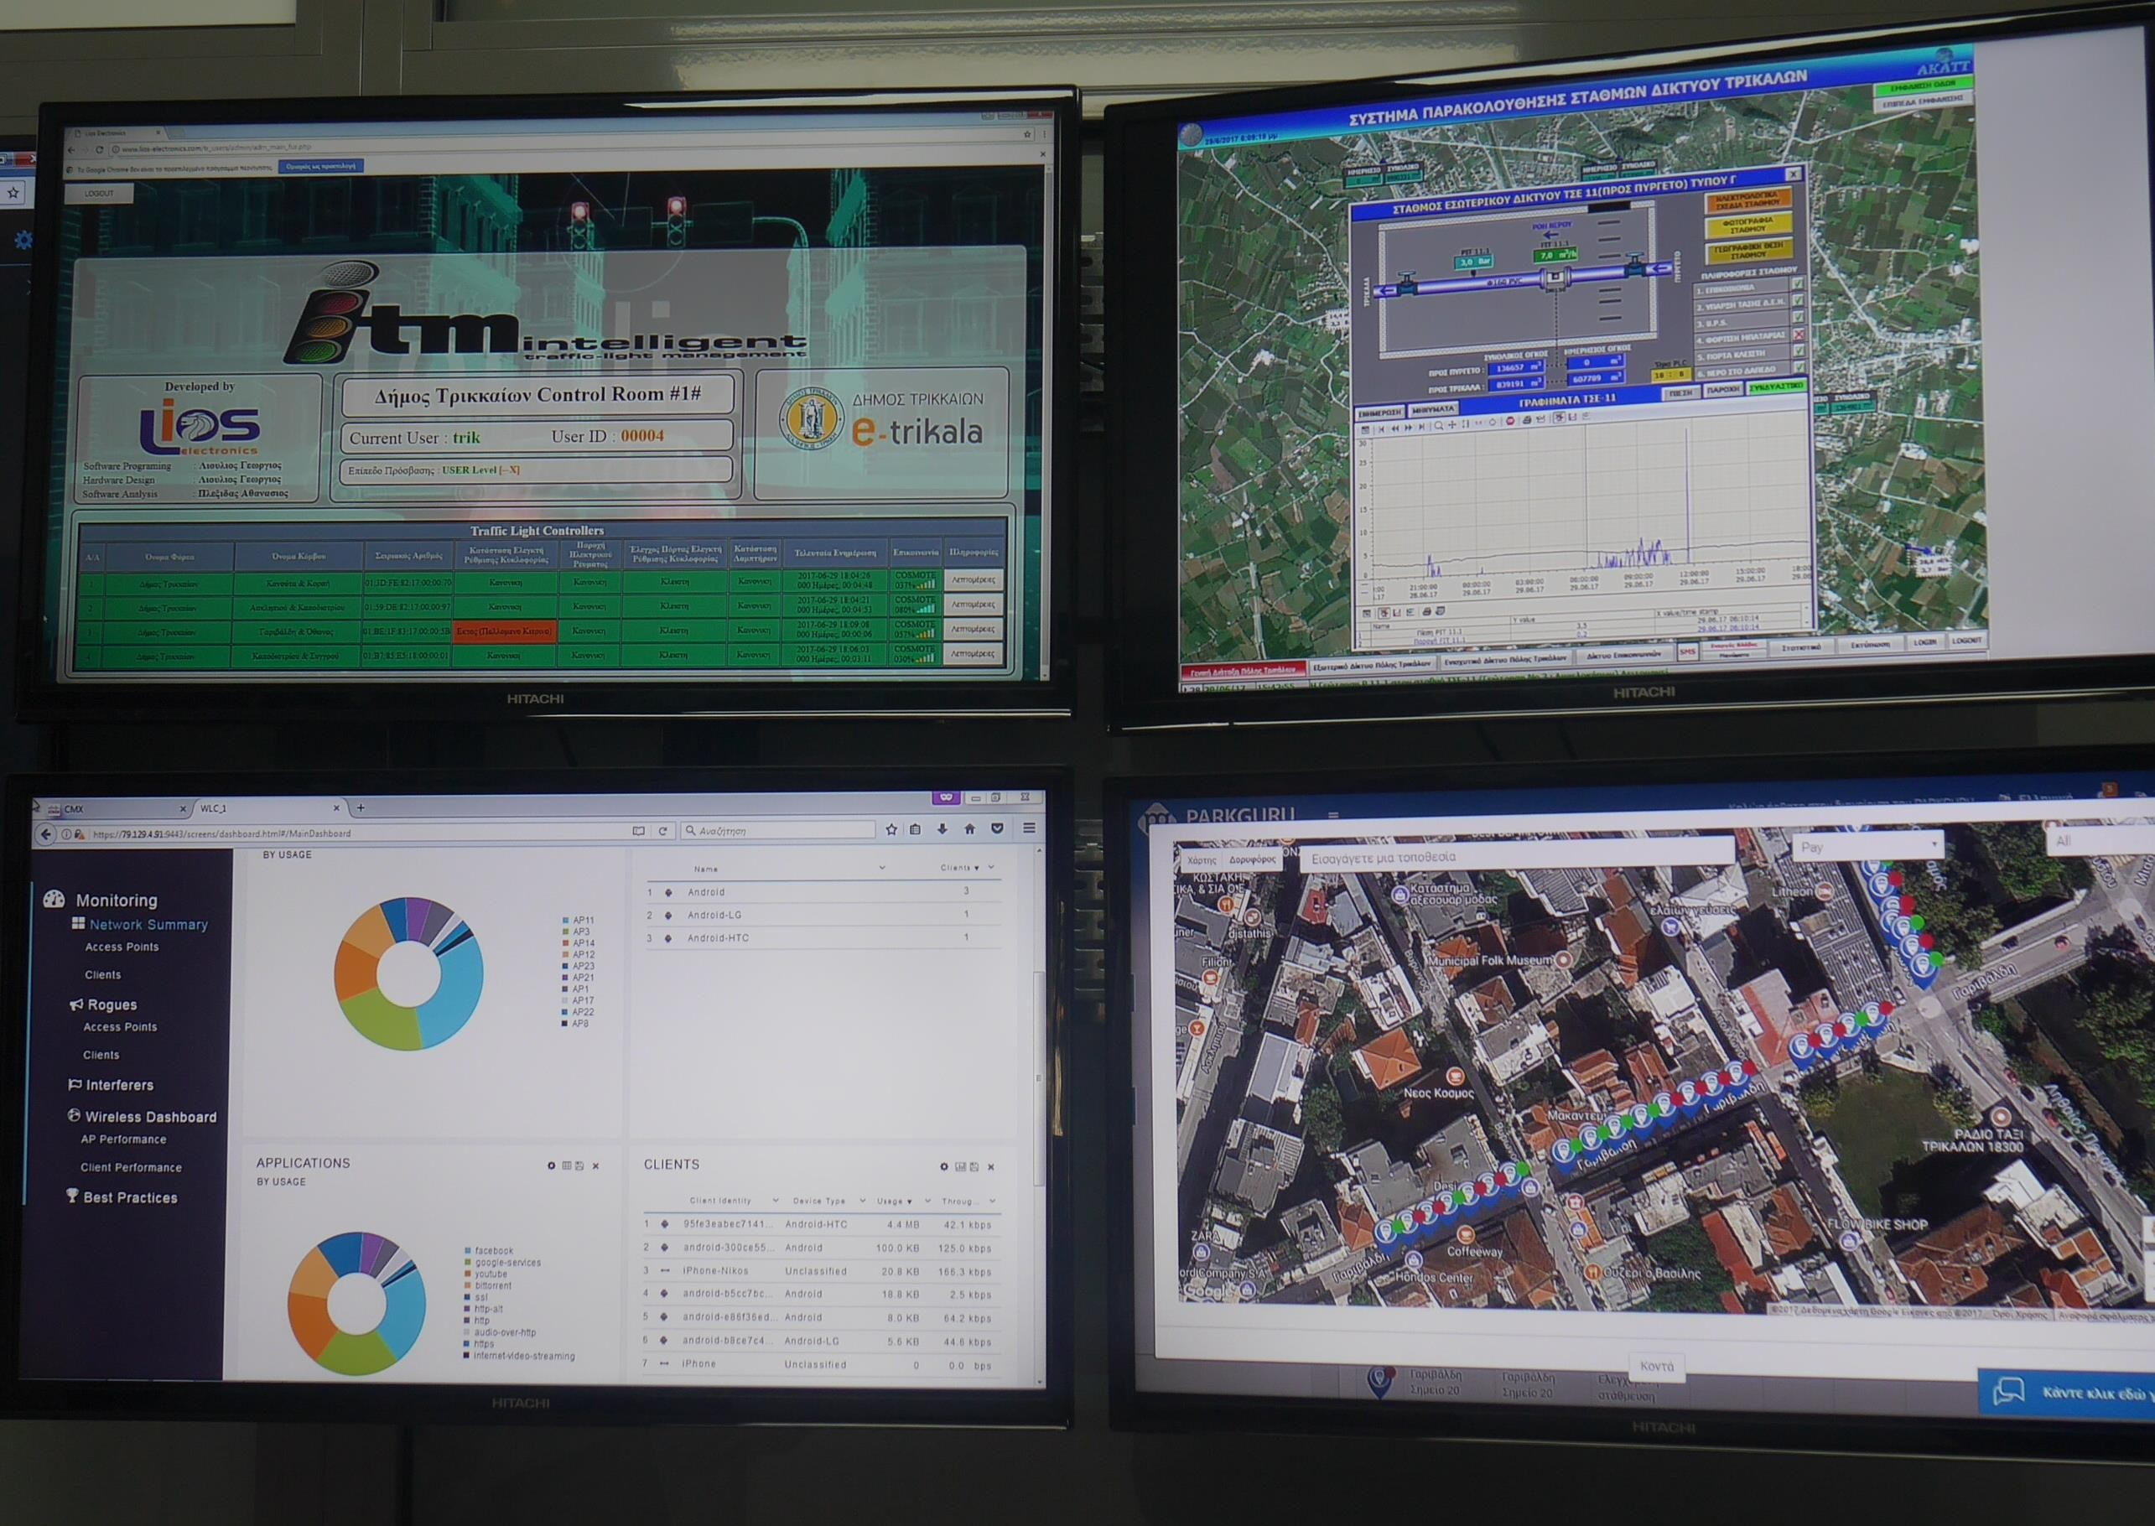
smarTrikala
A brief tour in the control room!
Traffic lights’ control system; Smart parking
Municipal budget progress on our open data section
Water pipe network’s remote control system
Street light remote control system, through Cisco API’s (Kinetic)

Slide 12
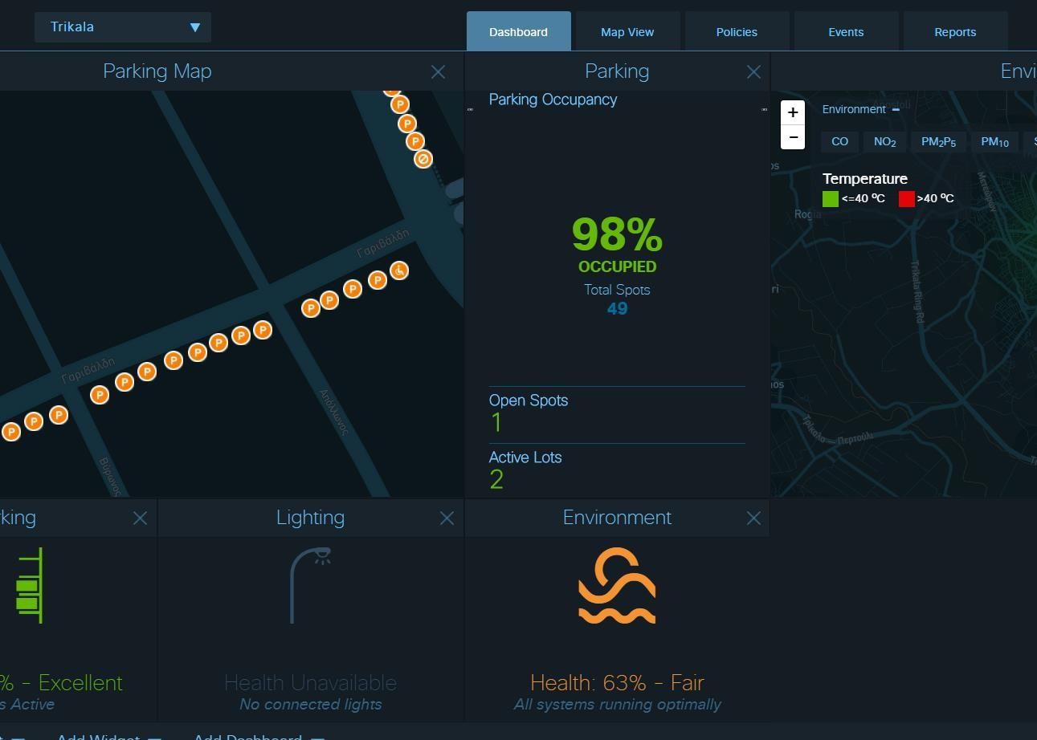
smarTrikala
A brief tour in the control room!
The “heart” is Cisco Kinetic, where most of the above systems are integrated and data is collected and analyzed (lighting, parking, environmental monitoring)

Slide 13
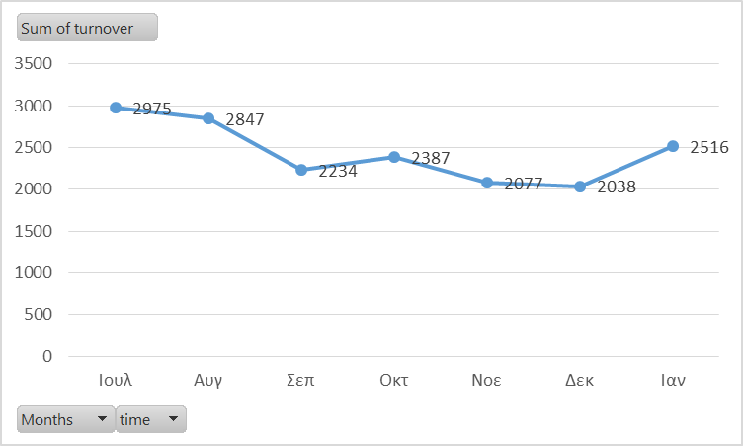
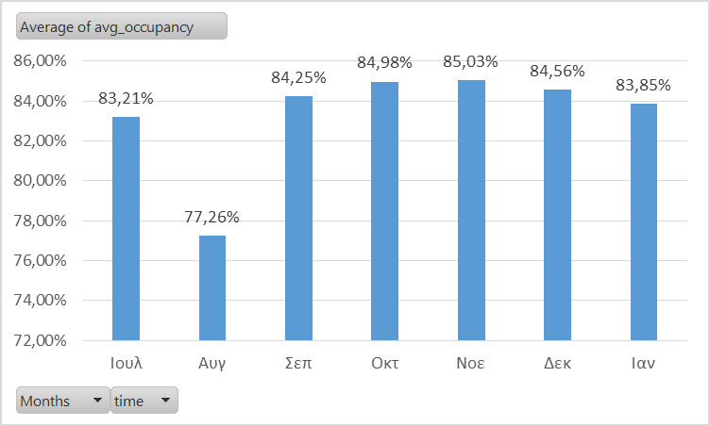
Trikala Results – Parking
Parking Sessions per month
17.074 sessions (Jul '17 - Feb '18)
83,3% avg occupancy (aprx 90% 8:00am-8:00pm)
4,3h avg duration
1.190 parking violations (150/month) - at Othonos, only 1 sensor
Occupancy per month

Slide 14
1Υ projection
Parking Sessions per month
Parking
occupancy (aprx 90% 8:00am-8:00pm)
365-52*2-31 = 230
1 euro : 230*11 = 2,530 euros
0.5 euro : 1,265 euros
Violations
120-150 per month / per lot
11 * 135 * 20 euros = 29,700 euros
Occupancy per month

Slide 15
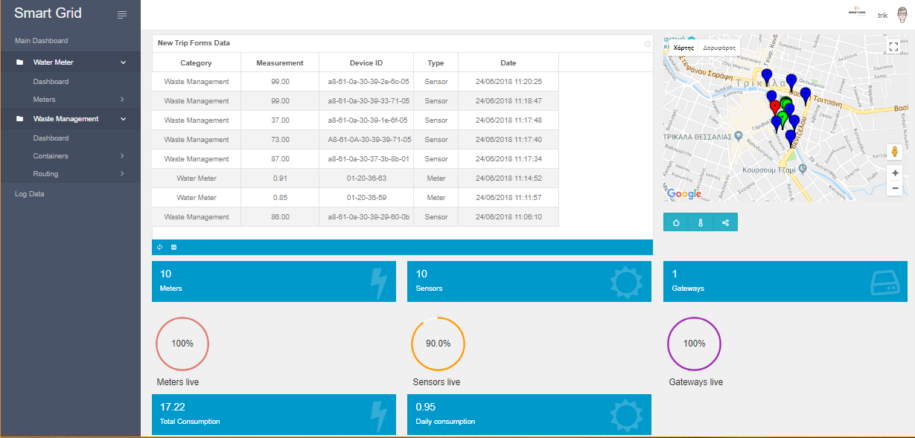
smarTrikala
More with IoT!
A set of Smart Bins and Smart meters have been installed in the city to measure and control garbage and consumption and improve accordingly

Slide 16
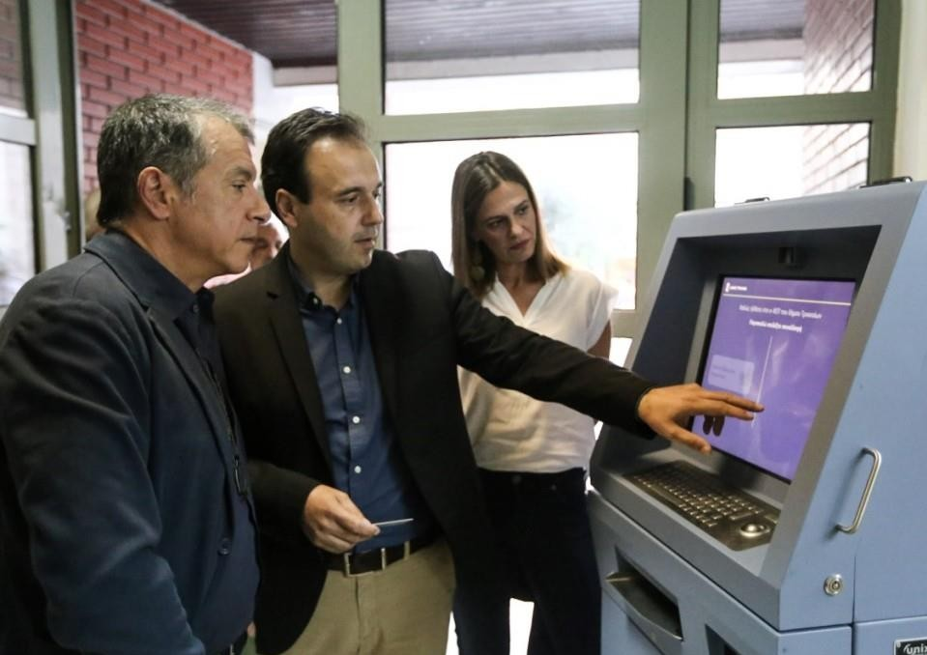
Citizen Self Service
Documents like certificates of birth, residency, and many others can be retrieved with the use of a NFC card (UnixFor)
smarTrikala

Slide 17
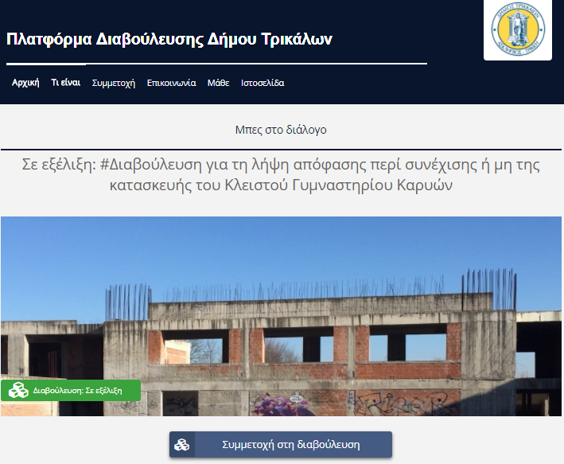
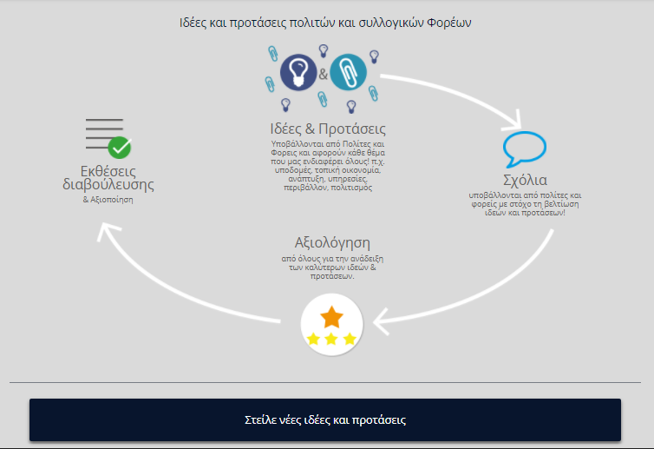
Public Consultation
It is “smart” to count your citizen’s needs, it is even smarter to make them happen if you can!
smarTrikala

Slide 18
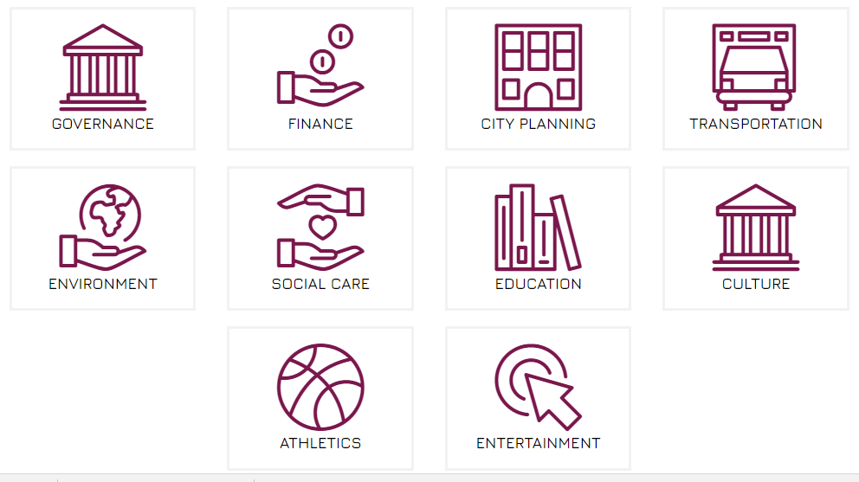
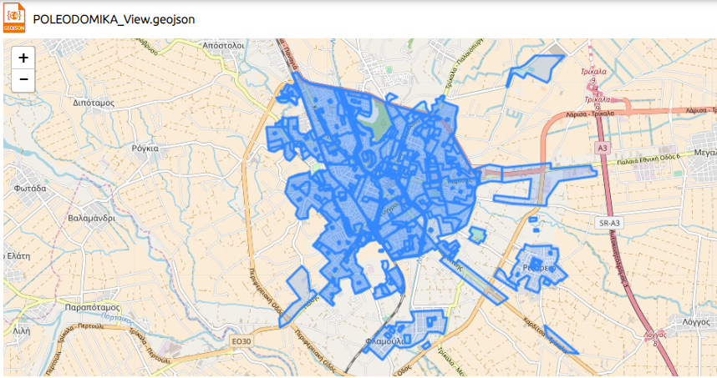
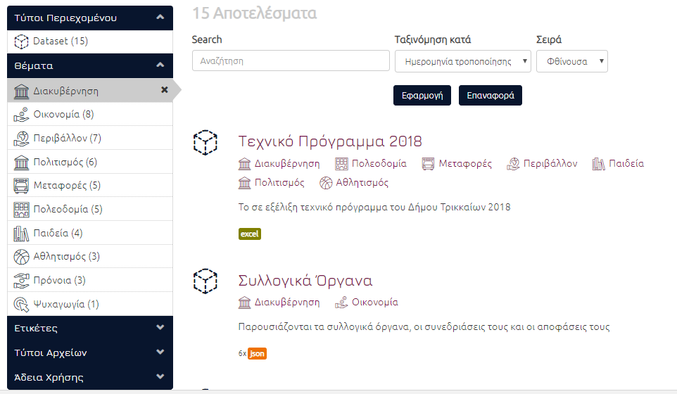
Open Data https://data.trikalacity.gr
Sept. 2018: 67 datasets several formats (json, geoJson, xml etc.)
smarTrikala

Slide 19
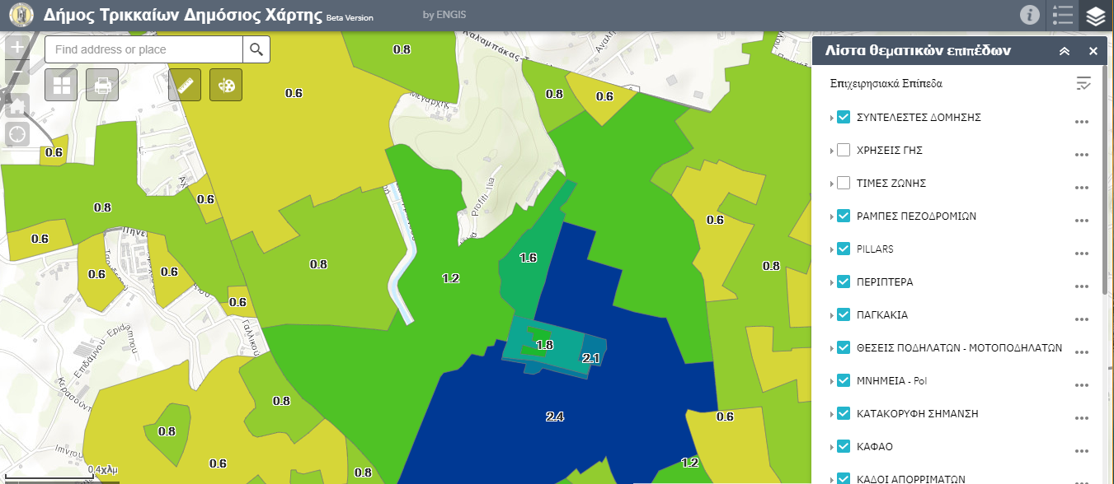
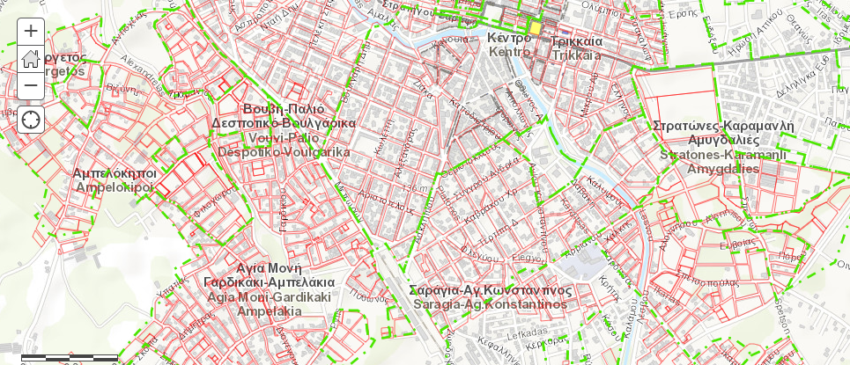
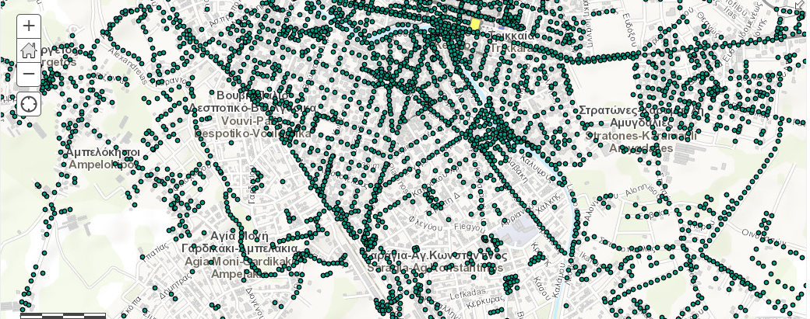
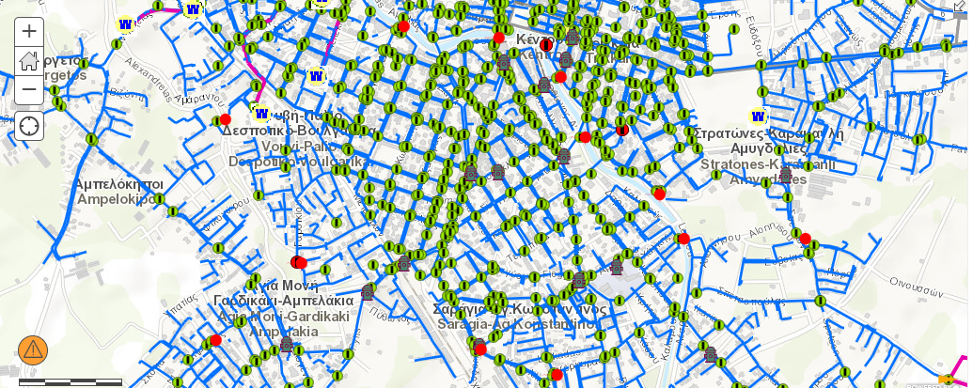
GIS
Long-lasting project
Sept. 2018: more than 15 layers for internal use
10 open layers for end users
smarTrikala

Slide 20
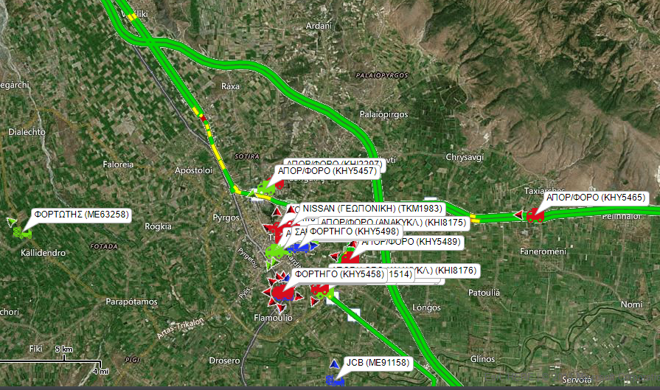
Fleet management
30 vehicles real-time monitoring annual route analysis
More than 30% fuel savings
smarTrikala

Slide 21

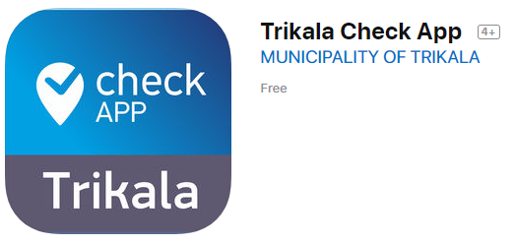
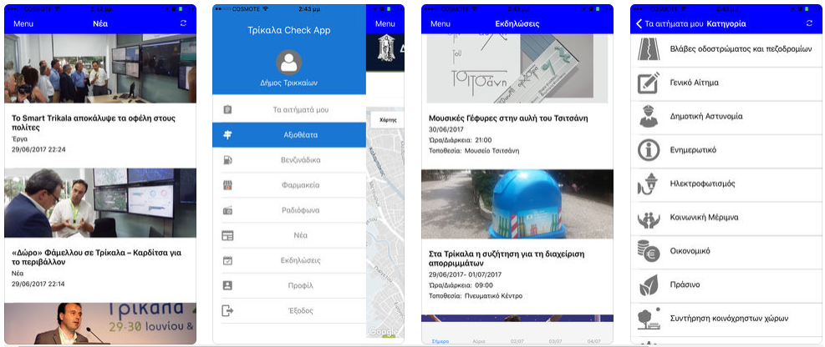
smarTrikala
The city … at the citizens’ hands!
Complaints registration
News/Events/Points of Interest etc.
Online payments
Consultation

Slide 22



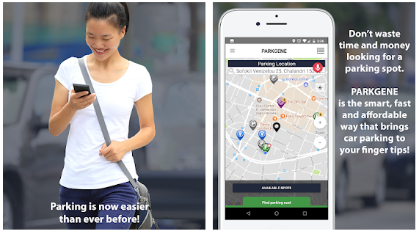
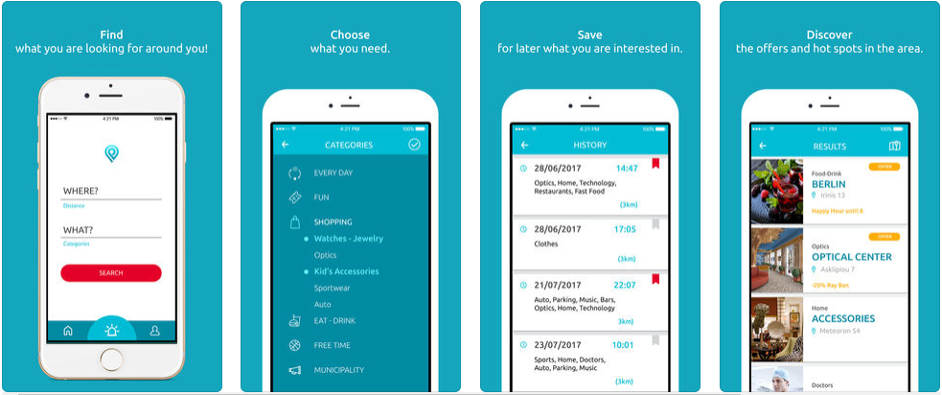
smarTrikala
Other apps!
Plision: volunteer management / market location
Parkguru: smart parking in the city
Novel ones on the go with the use of open data

Slide 23
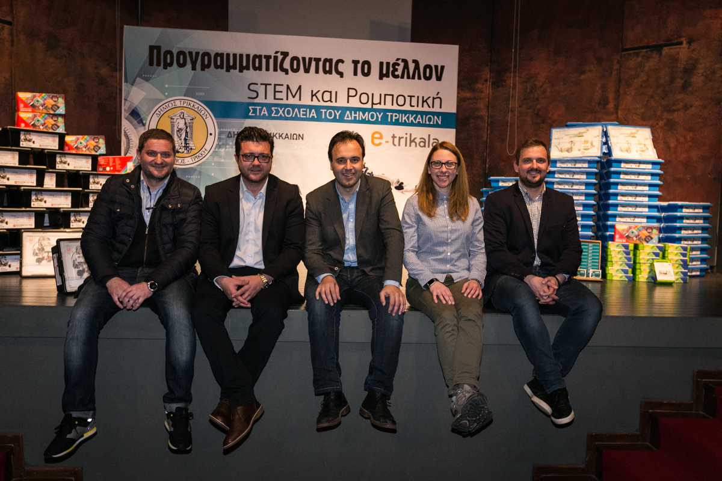
Skills
We recently distributed
several STEM kits to all the public schools:
55 Mindstorms Lego kits,
50 WeDo 2.0 Lego kits,
60 Arduino Starter kits
and trained teachers in partnership with
WRO Hellas
smarTrikala

Slide 24
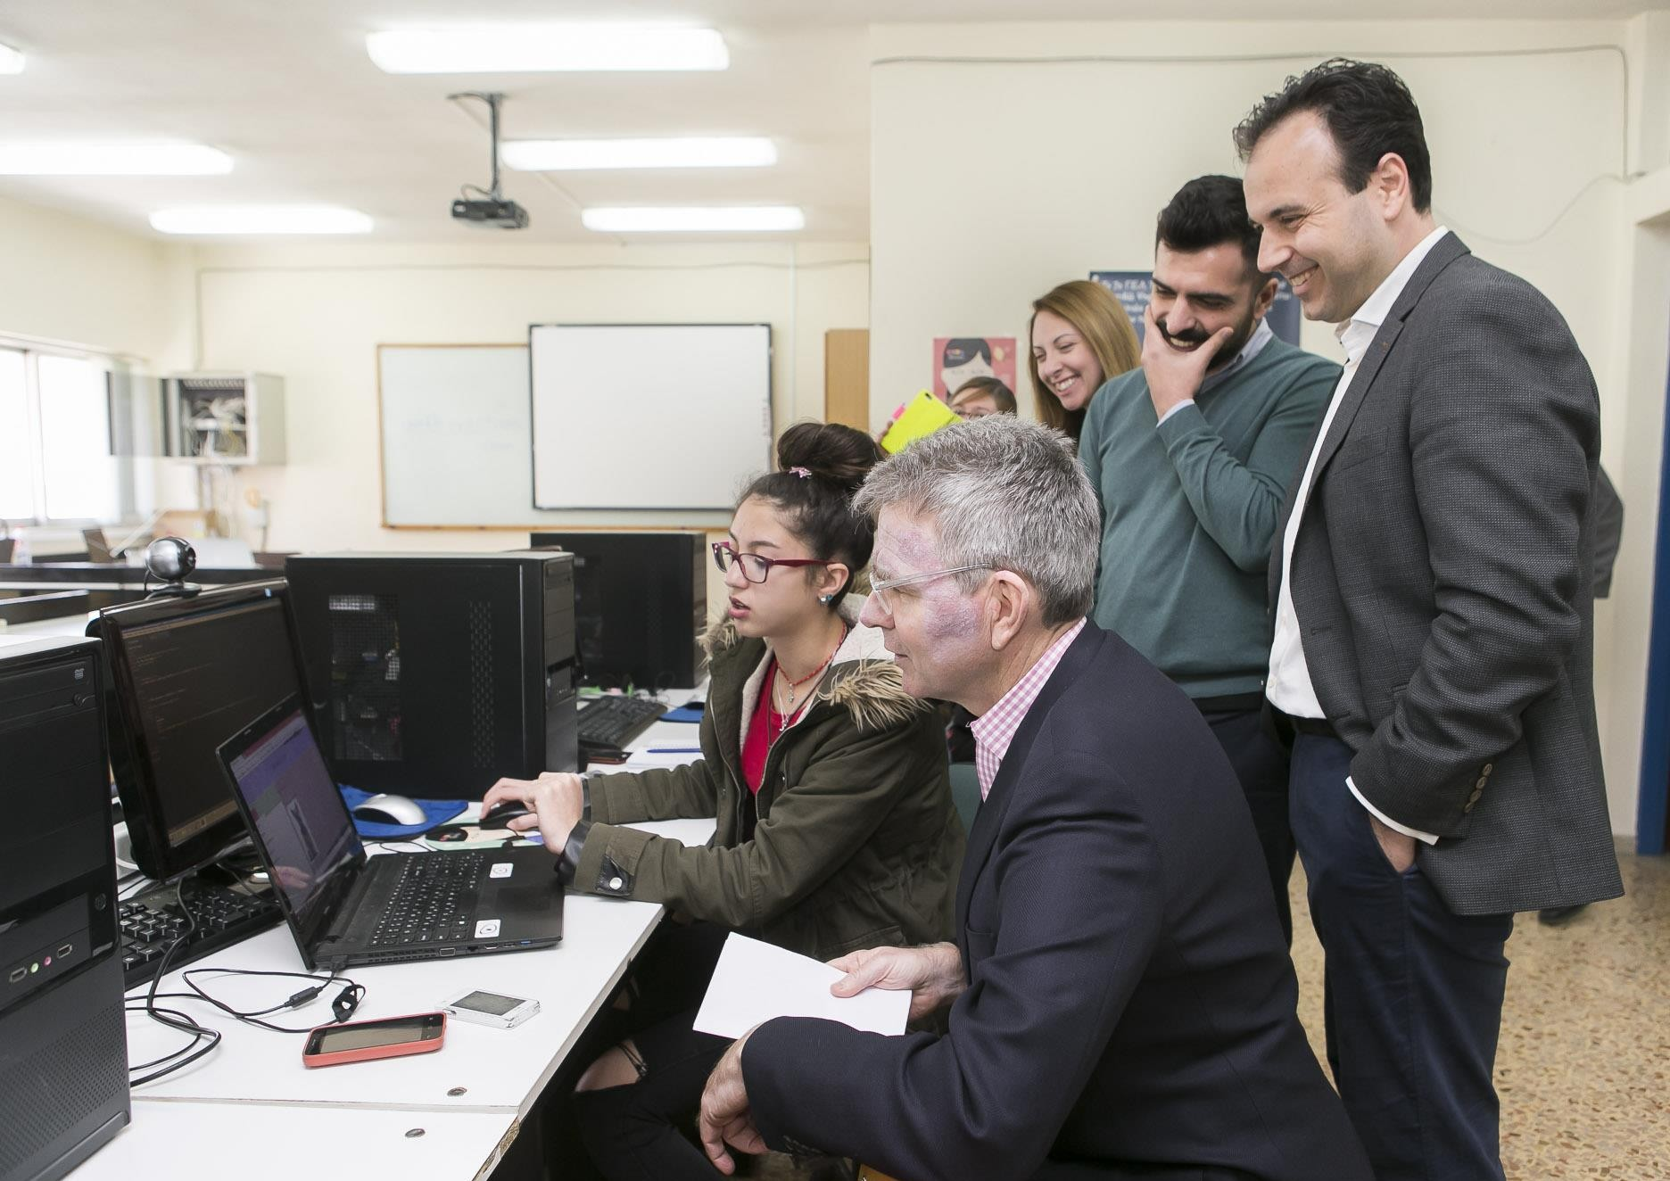
smarTrikala
Skills
We launched the project “Code Girls” in partnership with the US Embassy of Greece for high school girls

Slide 25
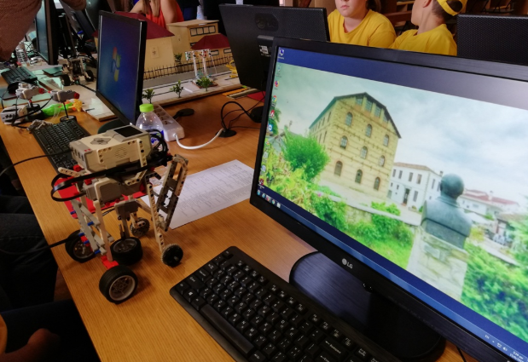
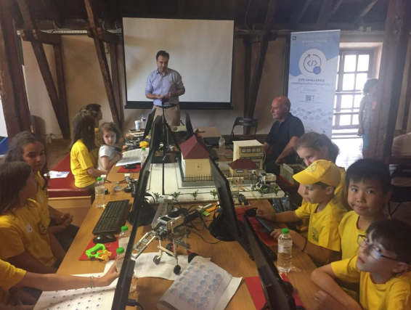

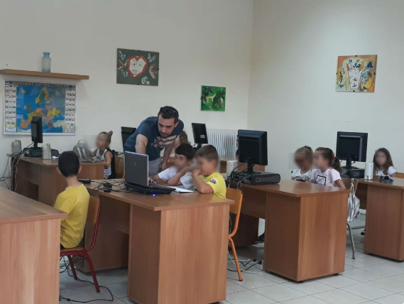
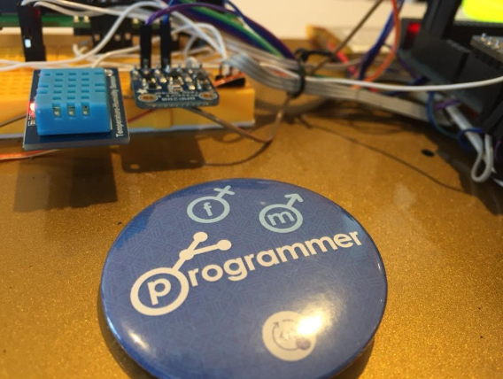
Skills
Training Programs:
Techtalents school
Cisco Academy
Hellenic Open Source Lab (ELLAK)
Campaigns
CrowdHackathon
CodeGirls
STEM
smarTrikala

Slide 26
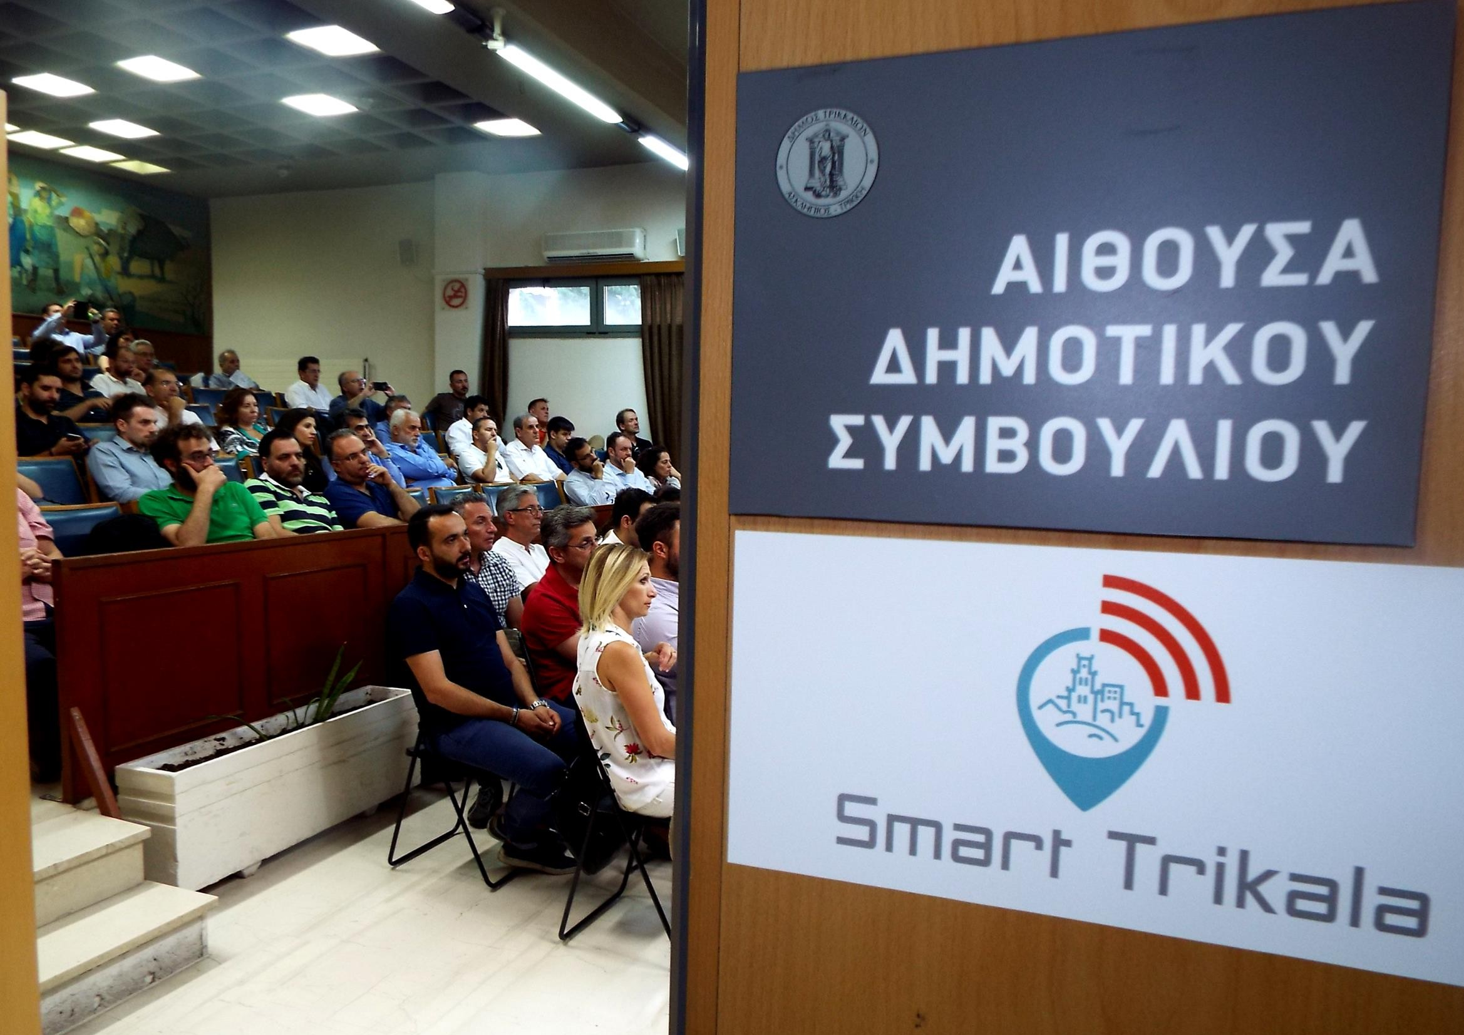
smarTrikala
Let’s… get smarter!
The Smart Trikala project was launched in 29/06/2017

Slide 27
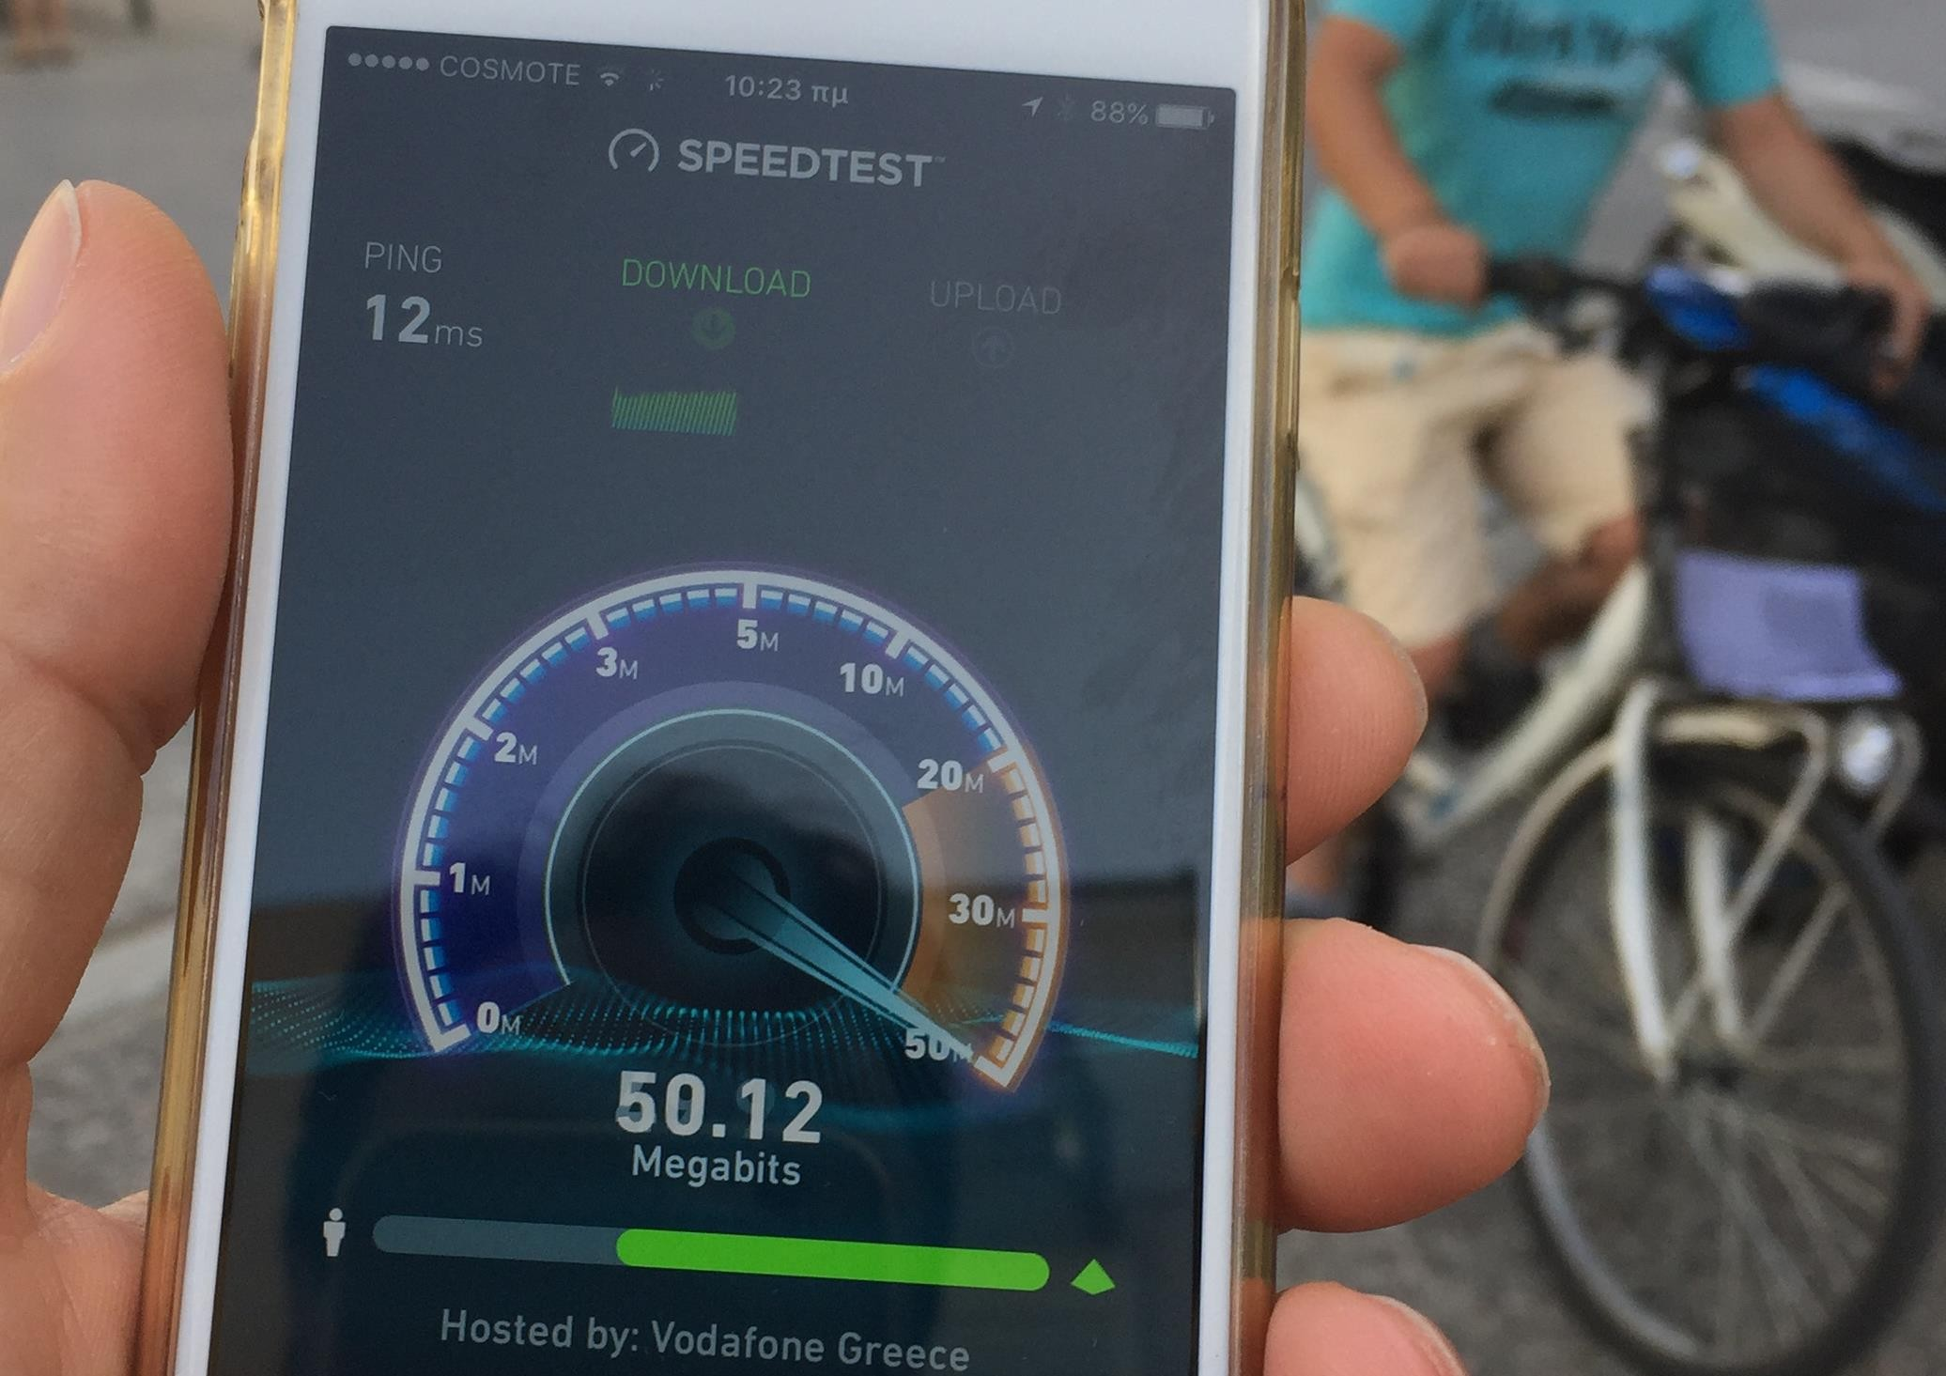
smarTrikala
Walk in the city!
Free WiFi (Cisco APP)
Open Mall application

Slide 28

50Mbps upload/download
2004
started
35
Gb per day
570
Users per day
65Access points

Slide 29
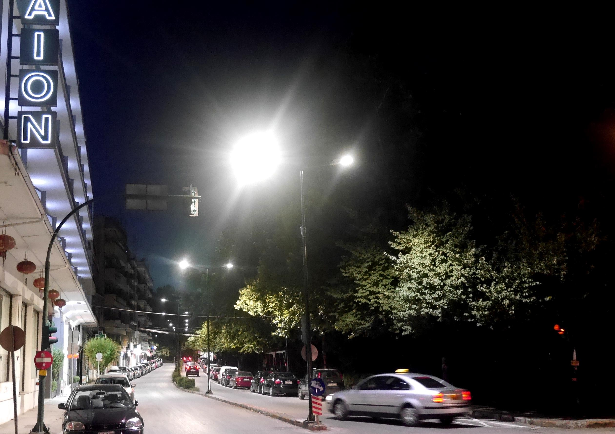
Walk in the city!
New LED street lighting with diming sensors.
Smart parking underground sensors
smarTrikala

Slide 30
Some reporting

Slide 31
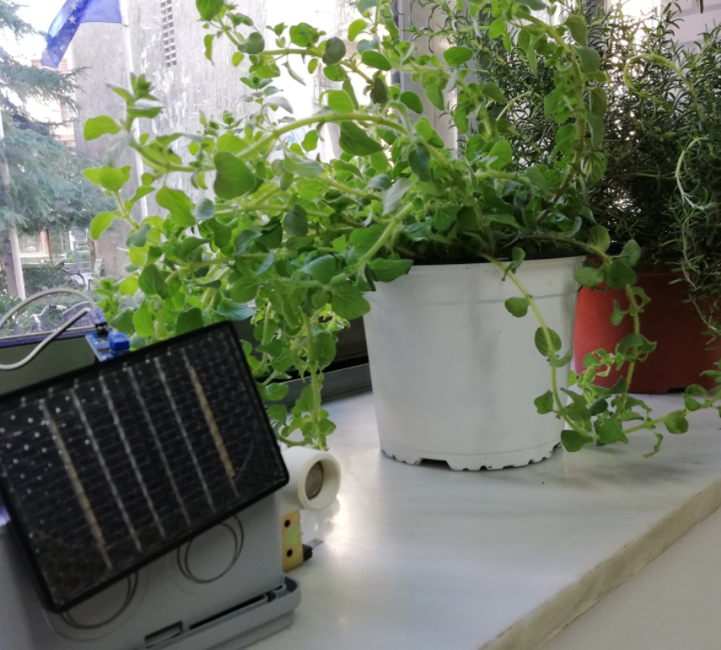
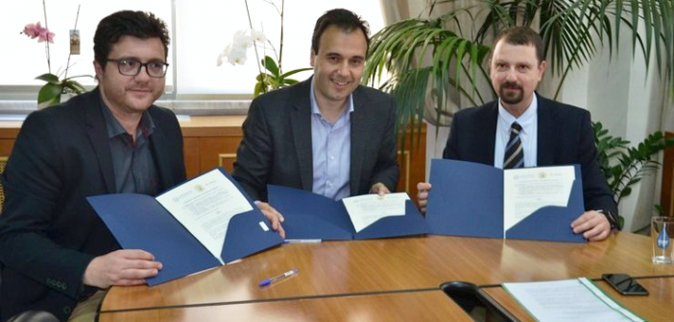
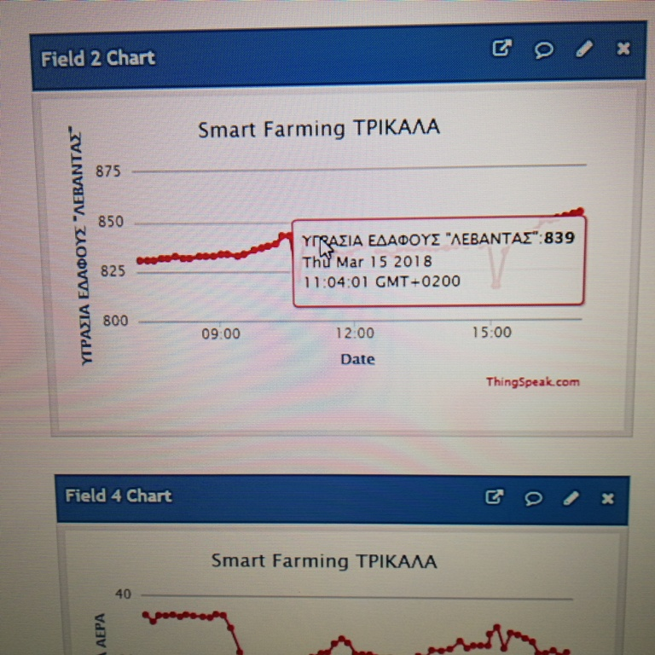
Emerging technologies!
Precise agriculture testing beds
IoT network (LoRa)
The first Greek 5G pilot
smarTrikala

Slide 32
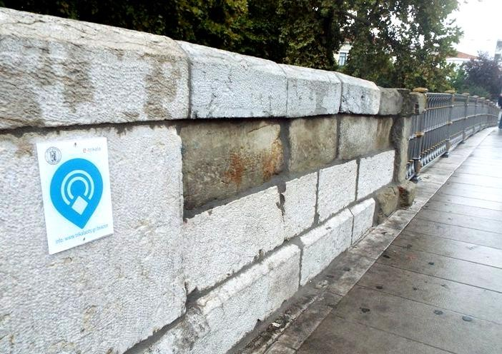
smarTrikala
Walk in the city!
Beacons for smart city tours.
You only need a physical web browser on your smartphone

Slide 33
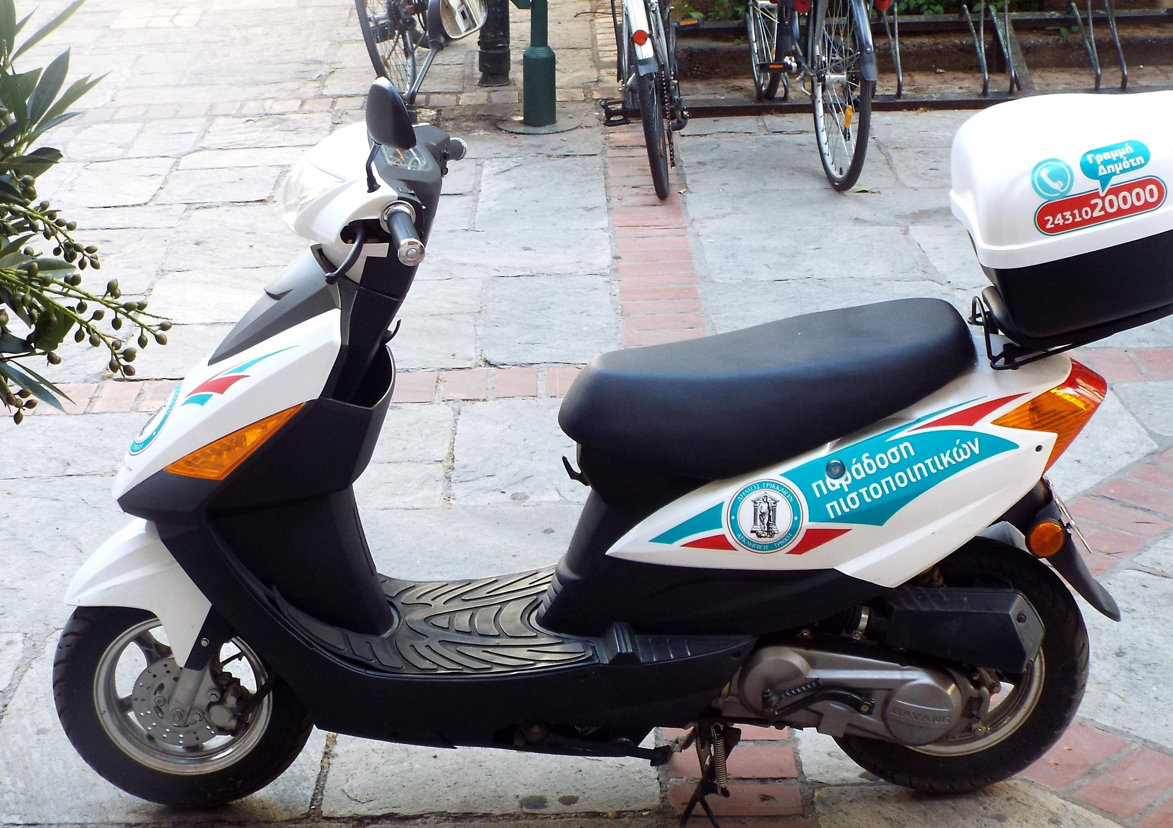
Walk in the city!
When you need printed public certificates and you don’t have time to get them!
smarTrikala

Slide 34
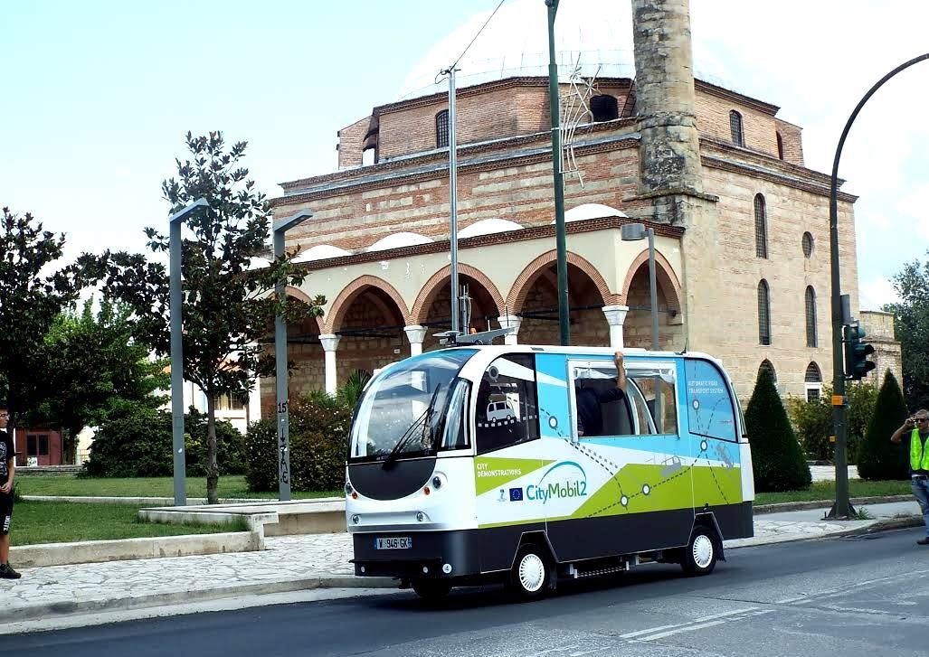
Walk in the city!
CityMobi2 driverless buses
pilot project (FP7)
6 months
6 buses
1.490 itinerary
3.580 kilometers
12.138 passengers
smarTrikala

Slide 35


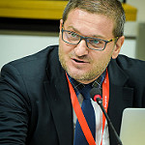
Please contact me for more information.
lanthopo@teilar.gr
Thank you for your attention!
http://smart.trikalacity.gr
http://de.teithessaly.gr/story/en-US/108/ANTHOPOULOS_Leonidas_Associate_Professor.html
https://scholar.google.gr/citations?user=oh6zqcUAAAAJ&hl=el&oi=ao
https://www.researchgate.net/profile/Leonidas_Anthopoulos,
https://gr.linkedin.com/in/https://gr.linkedin.com/in/leonidasanthopoulos

